Slide 1
Basic Database concepts
Data :- Raw facts and figures which are useful to an organization. We cannot take decisions on the basis of data.
Information:- Well processed data is called information. We can take decisions on the basis of information
Field: Set of characters that represents specific data element.
Record: Collection of fields is called a record. A record can have fields of different data types.

Slide 2
STRUCTURED QUERY LANGUAGE
( S Q L )

Slide 3
Structured Query Language
SQL is a non procedural language that is used to create, manipulate and process the databases(relations).
Characteristics of SQL
It is very easy to learn and use.
Large volume of databases can be handled quite easily.
It is non procedural language. It means that we do not need to specify the procedures to accomplish a task but just to give a command to perform the activity.
SQL can be linked to most of other high level languages that makes it first choice for the database programmers.

Slide 4
Structured Query Language
Processing Capabilities of SQL
The following are the processing capabilities of SQL.
1.Data Definition Language (DDL)
DDL contains commands that are used to create the tables, databases, indexes, views, sequences and synonyms etc.
e.g: Create table, create view, create index, alter table

Slide 5
Structured Query Language
Processing Capabilities of SQL
2. Data Manipulation Language (DML)
DML contains command that can be used to manipulate the data base objects and to query the databases for information retrieval.
e.g Select, Insert, Delete, Update.

Slide 6
Data types of SQL
Just like any other programming language, the facility of defining data of various types is available in SQL also. Following are the most common data types of SQL.
    NUMBER
    CHAR
    VARCHAR / VARCHAR2
    DATE
    LONG
    RAW/LONG RAW

Slide 7
SQL Commands
CREATE TABLE Command:
Create table command is used to create a table in SQL. It is a DDL type of command. The general syntax of creating a table is
create table <table> (
<column 1> <data type> [not null] [unique] [<column constraint>],
. . . . . . . . .
<column n> <data type> [not null] [unique] [<column constraint>],
[<table constraint(s)>]
);

Slide 8
SQL Commands
Constraints:
Constraints are the conditions that can be enforced on the attributes of a relation. The constraints come in play when ever we try to insert, delete or update a record in a relation.
NOT NULL
UNIQUE
PRIMARY KEY
FOREIGN KEY
CHECK
DEFAULT

Slide 9
SQL Commands
Operators in SQL:
The following are the commonly used operators in SQL
  Arithmetic Operators +, -, *, /
  Relational Operators =, <, >, <=, >=, <>
  Logical Operators OR, AND, NOT
Arithmetic operators are used to perform simple arithmetic operations.
Relational Operators are used when two values are to be compared and
Logical operators are used to connect search conditions in the WHERE Clause in SQL.

Slide 10
SQL Commands
Data Modifications in SQL
INSERT Statement
The simplest way to insert a tuple into a table is to use the insert statement
insert into <table> [(<column i, . . . , column j>)] values (<value i, . . . , value j>);
INSERT INTO student VALUES(101,'Rohan','XI',400,‘Chennai');
While inserting the record it should be checked that the values passed are of same data types as the one which is specified for that particular column.

Slide 11
Data Modifications in SQL
INSERT Statement
For inserting a row interactively (from keyboard) & operator can be used.
e.g INSERT INTO student VALUES(&Roll_no’,’&Name’,’&Class’,’&Marks’,’&City’);
In the above command the values for all the columns are read from keyboard and inserted into the table student.

Slide 12
TABLE : STUDENT
Roll_no | Name | Class | Marks | City
101 | Rohan | XI | 400 | Chennai
102 | Aneeta | XII | 390 | Bengaluru
103 | Pawan Kumar | IX | 298 | Mysore
104 | Rohan | IX | 376 | Mangalore
105 | Sanjay | VII | 240 | Mumbai
113 | Anju | VIII | 432 | Delhi

Slide 13
SELECT Command
SELECT * FROM student; command will display all the tuples in the relation student
SELECT * FROM student WHERE Roll_no <=102;
The above command display only those records whose Roll_no less than or equal to 102.
Select command can also display specific attributes from a relation.
SELECT name, class FROM student;
The above command displays only name and class attributes from student table.

Slide 14
SELECT Command
SELECT count(*) AS “Total Number of Records” FROM student;
Display the total number of records with title as “Total Number of Records” i.e an alias
We can also use arithmetic operators in select statement, like
SELECT Roll_no, name, marks+20 FROM student;
SELECT name, (marks/500)*100 FROM student WHERE Roll_no > 103;

Slide 15
ORDER BY Clause
e.g. SELECT * FROM student ORDER BY city DESC;
It displays all the records of table student ordered by city in descending order.

Slide 16
GROUP BY Clause
aggregate_function can be a function such as SUM, COUNT, MAX, MIN, AVG etc.
e.g SELECT name, COUNT(*) as "Number of
employees“ FROM student WHERE marks>350
GROUP BY city;

Slide 17
HAVING Clause
e.g SELECT SUM(marks) as "Total marks"
FROM student
GROUP BY department
HAVING SUM(sales) > 1000;

Slide 18
ALTER TABLE Command
In SQL if we ever need to change the structure of the database then ALTER TABLE command is used. By using this command we can add a column in the existing table, delete a column from a table or modify columns in a table.
Adding a column
The syntax to add a column is:-
ALTER TABLE table_name
ADD column_name datatype;

Slide 19
DROP TABLE Command
Sometimes you may need to drop a table which is not in use. DROP TABLE command is used to Delete / drop a table permanently. It should be kept in mind that we can not drop a table if it contains records. That is first all the rows of the table have to be deleted and only then the table can be
dropped.
The general syntax of this command is:-
  DROP TABLE <table_name>;
  e.g DROP TABLE student;
  This command will remove the table student

Slide 20
java
Java is platform independent: the same program can run on any correctly implemented Java system
Java is object-oriented:
  Structured in terms of classes, which group data with operations on that data
  Can construct new classes by extending existing ones
Java designed as
  A core language plus
  A rich collection of commonly available packages
Java can be embedded in Web pages

Slide 21
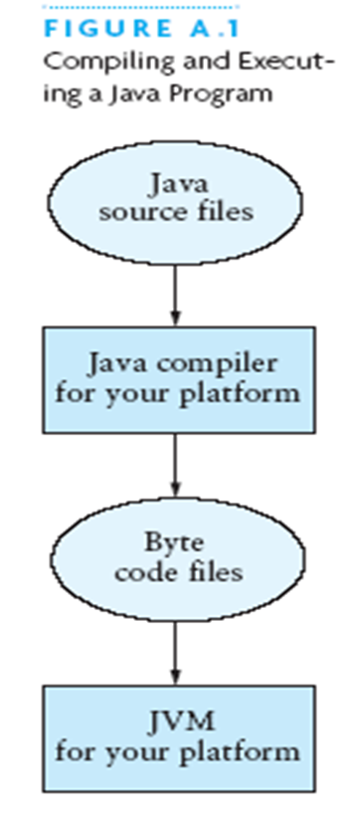

Slide 22
Java program
import java.util.*;
public class HelloWorld { // starts a class
public static void main (String[] args) {
// starts a main method
// in: array of String; out: none (void)
}
}
public = can be seen from any package
static = not “part of” an object

Slide 23
Data types:
Java distinguishes two kinds of entities
  Primitive types
  Objects
Primitive-type data is stored in primitive-type variables
Reference variables store the address of an object

Slide 24
Control statements
A group of statements executed in order is written
  { stmt1; stmt2; ...; stmtN; }
The statements execute in the order 1, 2, ..., N
Control statements alter this sequential flow of execution

